Slide 1
Visual Sentiment Analysis Using Machine Learning
UNDER DR. ANNUSHREE BABLANI

Slide 2
Group - B22AB04
NAME | ROLL NO
PIYUSH KUMAR | S20190010141
ANURAG KUMAR | S20190010009
HIMESH KUMAR | S20190010065

Slide 3
Outline
Motivation
Problem Statement
Work done Before Mid Review
Work done After Mid Review
Methodology
Result
Future Work

Slide 4
Motivation
Sentiment analysis is attracting more attention and has become a very hot research topic.
Most of the existing methods are based on single modality data.
Mining sentiment information from these data is of great important for applications.
Plenty of works have been published, significantly promoting the development of sentiment analysis studies.
Memes are commonly used in social media platforms for humor generally.
Memes can be used to spread hate or misinformation , hence it is important to study them.

Slide 5
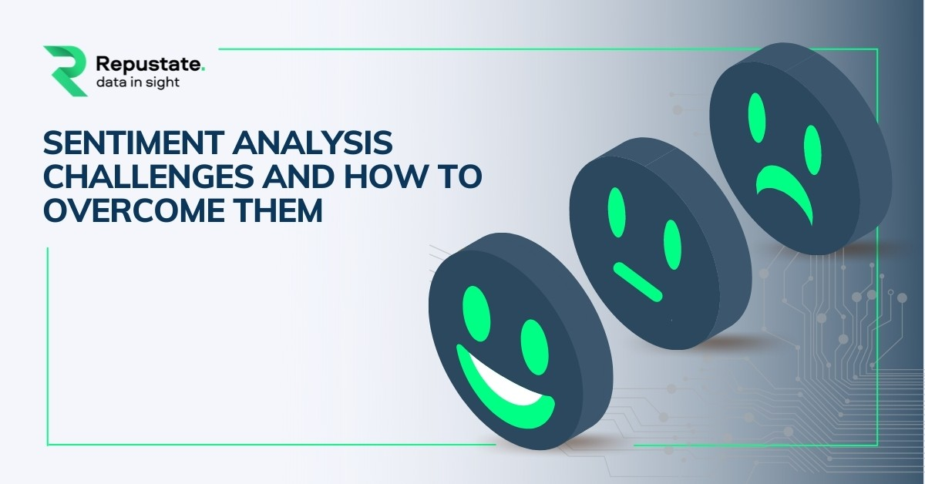
Problem Statement
Designing a machine learning model to analyze the sentiments of memes, i.e positive, negative or neutral.

Slide 6
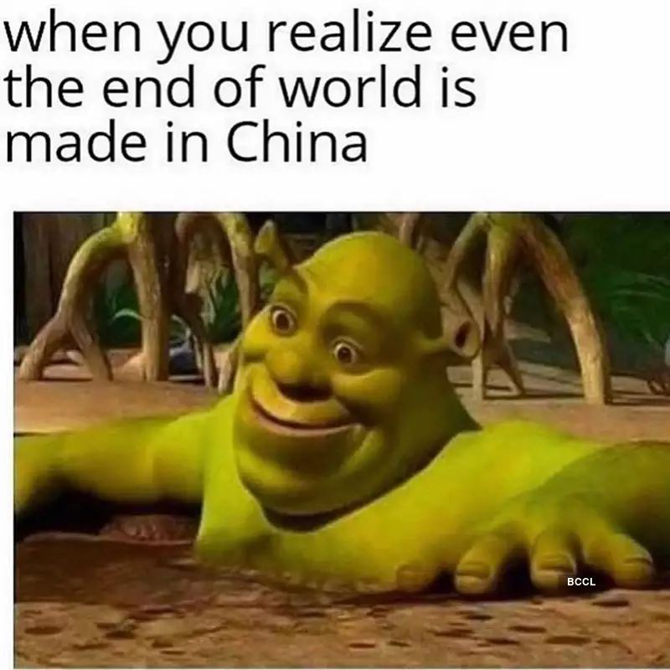
Work done Before Mid Review
Literature Survey
Multimodal vs Unimodal
Comparative Study of Algorithms
- BERT
- LSTM
- VGG
- BiLSTM

Slide 7
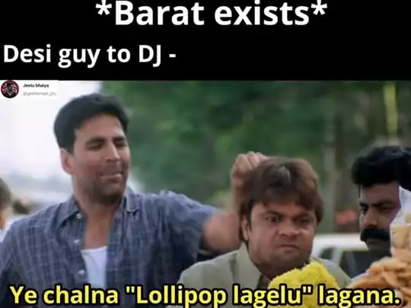
Work done After Mid Review
Data Preprocessing
- Data Cleaning
- Data Plotting
OCR (Optical Character Recognition )
Image Captioning
LSTM Model (CNN + RNN)

Slide 8
Methodology

Slide 9
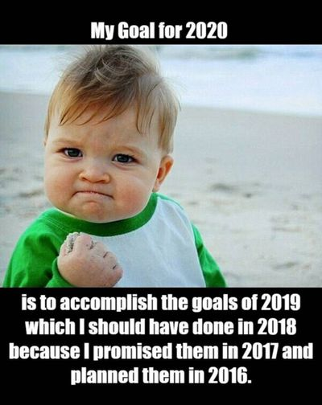
Proposed Approaches
Approach 1 - In this approach we have tried to implement the model used in the reference paper resulting in an optimized accuracy score of 42.92 min, 59.893(avg. ) and 74.39 max for 10 epochs, batch size of 32 .
Approach 2 - In this approach we propose to optimize the accuracy score further by using google text classification library BERT , along with other (CNN + RNN ) models like VGG16 or VGG19, Bi-LSTM, LSTM .

Slide 10
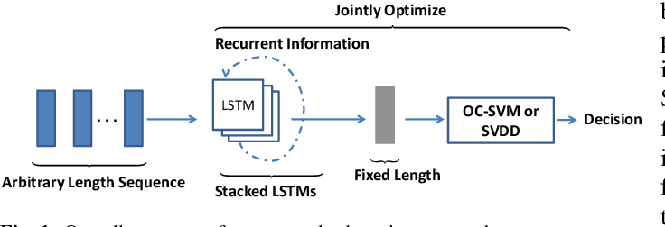
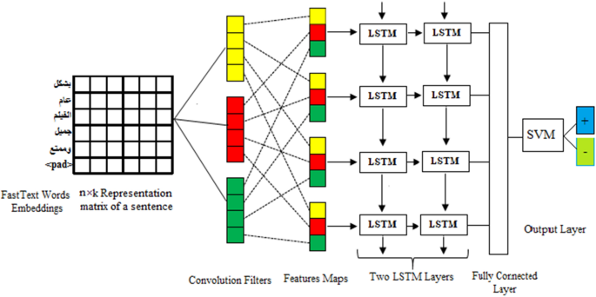

Slide 11
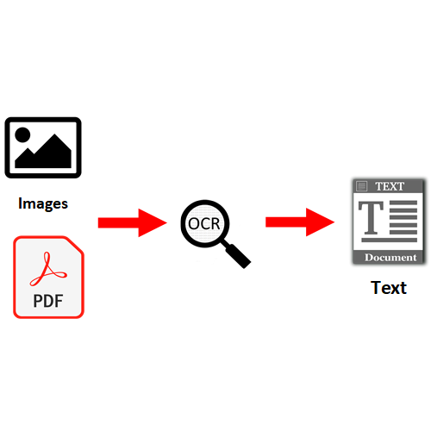
Text OCR (Optical Character Recognition)
Optical character recognition (OCR) is sometimes referred to as text recognition. An OCR program extracts and repurposes data from scanned documents, camera images and image-only pdfs. OCR software singles out letters on the image, puts them into words and then puts the words into sentences, thus enabling access to and editing of the original content. It also eliminates the need for manual data entry.
Google Vision Api - The vision API helps us to detect and extract text from images. It has two annotations :
Text From Images
Text From Documents

Slide 12
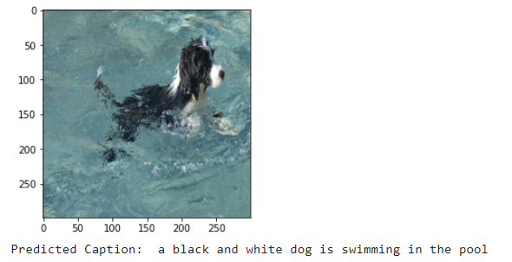
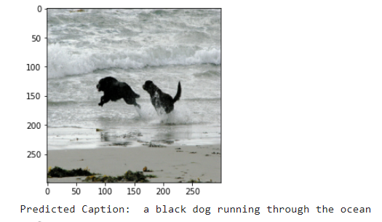
Image Captioning
Image Captioning - Image Captioning is the process of generating textual description of an image. It uses both Natural Language Processing and Computer Vision to generate the captions.
It’s majorly split into four sections :
Encoder
Decoder
Training
Testing

Slide 13
DATASET

Slide 14
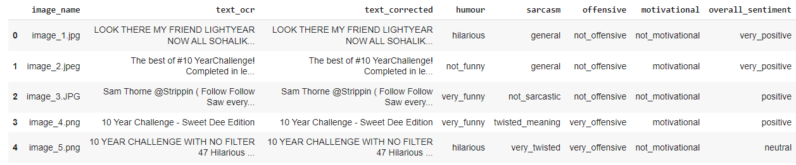
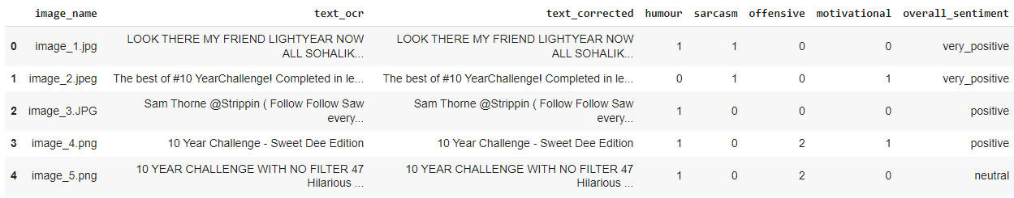

Slide 15
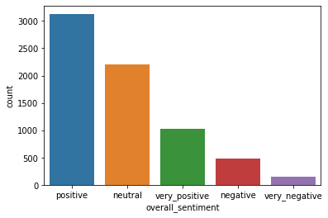
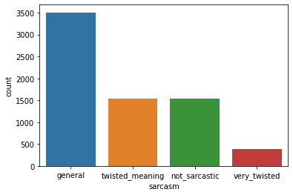
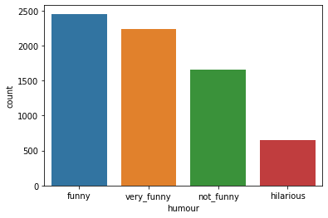
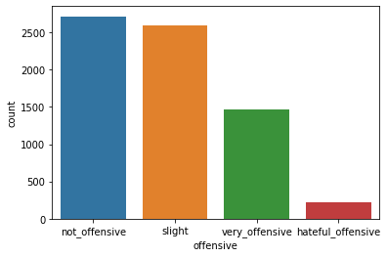

Slide 16
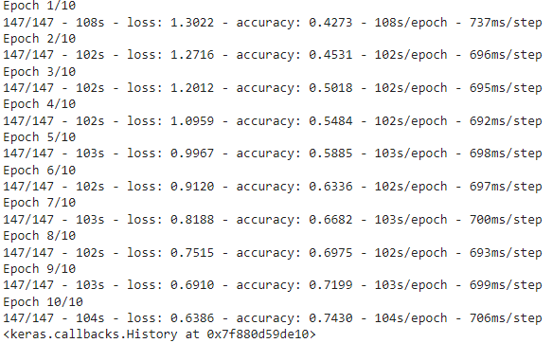
Result
Accuracy - 59.813
Loss - 0.9642
Epochs - 10
Batch Size - 32

Slide 17
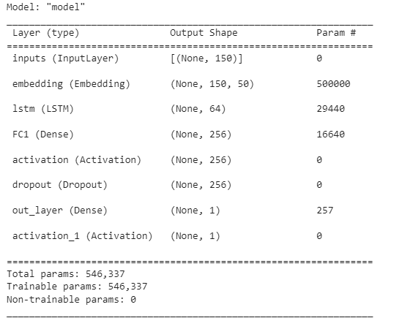

Slide 18
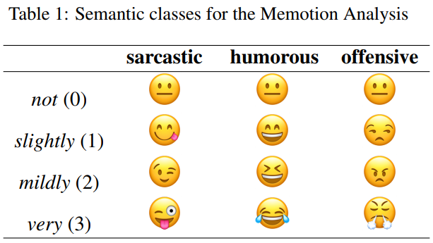
Future Work
Optimizing the accuracy score
New algorithm pairs
- BERT + VGG
- BERT + Bi-LSTM
- BERT + LSTM

Slide 19
Timeline
Mid Review - 1
Literature Review
Mide Review - 2
Approach 2
Model Implementation
2022
2022
2022
2022
End Review - 1
Data Preprocessing, Approach 1 implementation
End Review - 2
Model Optimization and final project submission

Slide 20
References
Niu T, Zhu S, Pang L, et al (2016) Sentiment analysis on multi-view social data. In: Proceedings of International Conference on Multimedia Modeling, 15–27
Alluri, N. V., & Krishna, N. D. (2021). Multimodal Analysis of memes for sentiment extraction. arXiv preprint arXiv:2112.11850.
C. Sharma, D. Bhageria, W. Paka, Scott, S. P Y K L, A. Das, T. Chakraborty, V. Pulabaigari, B. Gambäck, SemEval-2020 Task 8: Memotion Analysis-The Visuo-Lingual Metaphor!, in:Proceedings of the 14th International Workshop on Semantic Evaluation (SemEval-2020),Association for Computational Linguistics, Barcelona, Spain, 2020.

Slide 21
Thank You!
Memes are the new messages

